Slide 1
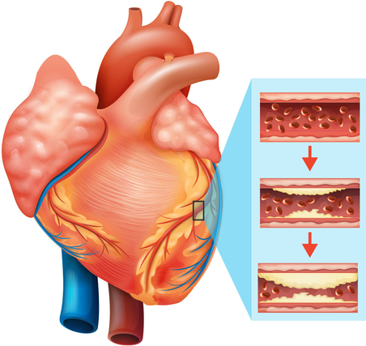

Data Analytics Internship Program 2024
Final Project Presentation
Project Name: Heart Disease diagnostic Analysis
Unique ID : IBM1250
Team Name : The Analyzers
College : Government Engineering
College Bikaner
IBM SkillsBuild for Adult Learners - Data Analytics

Slide 2





Team Members:
Jayant Golcha
Team Lead
Concept Note Build
Nilesh Tamboli
Code Builder
Chetan Sharma
Presentation
Arabaj Hashmee
Project Research
Anil Sharma
Code Reviewer

Slide 3
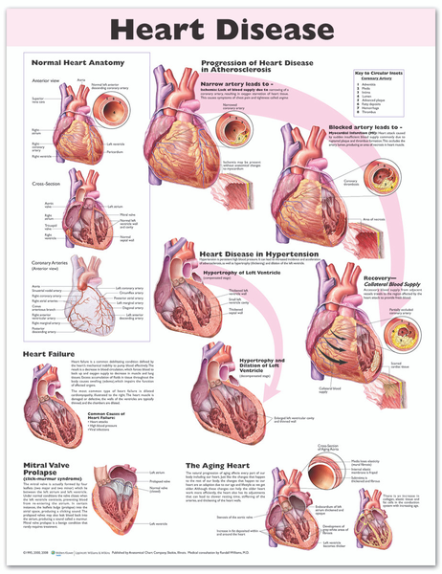
Introduction:
Heart disease, also known as cardiovascular disease (CVD), refers to a group of conditions that affect the heart and blood vessels. It occurs when plaque builds up in the walls of the arteries, leading to narrowing or blockage of blood flow to the heart, brain, or other vital organs.
Problem Statement:
The high rate of heart diseases in a specific population (e.g. urban vs. rural, male vs. female) require a targeted approach to reduce the burden. To achieve this, we aim to identify the most significant risk factors, including chest pain type (4 values), resting blood pressure, fasting blood sugar (> 120 mg/dl) and examine their relationships with heart disease outcomes.
By answering these questions, we can develop evidence-based strategies to reduce the risk of heart disease and improve health outcomes in this population.

Slide 4

Objective of the project:
The primary objective of this project is to analyse blood pressure, blood sugar, chest pain type etc. data to identify the major sources and trends of heart attacks and to propose data-driven solutions that can help reduce Heart Diseases.
The specific objectives are:
➢ To collect and analyze heart related data from reliable sources.
➢ To identify the primary sources of heart attack in people.
➢ Does the average Maximum Heart Rate (thalach) tend to be lower for patients without heart disease comparing to those who have the disease? ➢ To develop predictive models for future heart diseases based on current data.
➢ Is there a significant association between the type of chest pain (cp) and the presence of exercise-induced angina (exang)?
➢ To assess the potential impact of these solutions on achieving SDG 3

Slide 5
Significance of the Problem:
According to the Center for Disease Control and Prevention (CDC), heart disease is the leading cause of death in the US, accounting for over 655,000 deaths in 2020. The World Health Organization's Southeast Asia Region reports that CVD is responsible for approximately 2.5 million deaths per year, with CHD being a significant contributor.
Relevant SDGs:
SDG 6: "Water, Sanitation, and Hygiene" This goal aims to ensure that everyone has access to clean water and sanitation.
SDG 13: "Health and Climate Action" This goal aims to combat climate change and its effects on health.
Reproductive, maternal, newborn, child, and adolescent health: This is a major health priority addressed by SDG 3.
Universal health coverage: This goal aims to ensure that everyone can access quality health services without financial hardship.
Access to safe, effective, quality, and affordable medicines and vaccines: This goal is another priority of SDG 3.

Slide 6
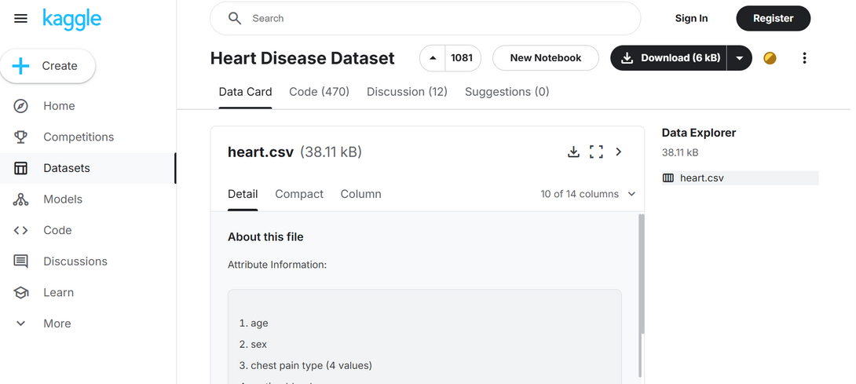
Data Collection
Source of Data:-Kaggle
Link:
Heart Disease Dataset

Slide 7
2. Data Description
This data set dates from 1988 and consists of four databases: Cleveland, Hungary, Switzerland, and Long Beach V. It contains 76 attributes, including the predicted attribute, but all published experiments refer to using a subset of 14 of them. The "target" field refers to the presence of heart disease in the patient. It is integer valued 0 = no disease and 1 = disease.
age
sex
chest pain type (4 values)
resting blood pressure
serum cholestoral in mg/dl
fasting blood sugar > 120 mg/dl
resting electrocardiographic results (values 0,1,2)
maximum heart rate achieved
exercise induced angina
oldpeak = ST depression induced by exercise relative to rest
the slope of the peak exercise ST segment
number of major vessels (0-3) colored by flourosopy
thal: 0 = normal; 1 = fixed defect; 2 = reversable defect
The names and social security numbers of the patients were recently removed from the database, replaced with dummy values.

Slide 8
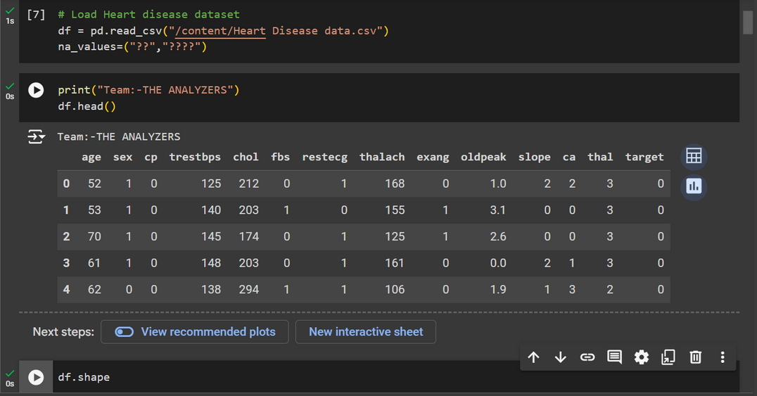
3. Data Collection Methods
Data is collected using read_csv method provided by pandas library

Slide 9
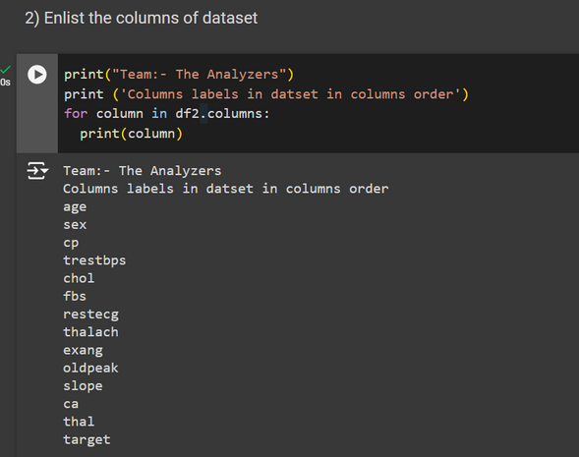
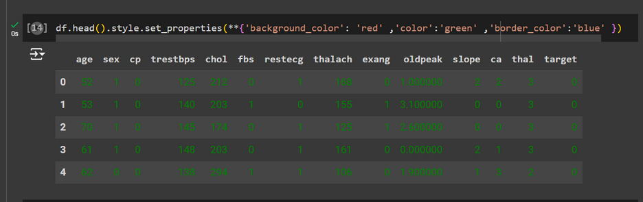
B. Data Preprocessing
1)Data Cleaning Methods:
Checking Columns and finding null values, repeated values to clean the dataset.
Coloring the dataset values to easily access the required columna data.

Slide 10
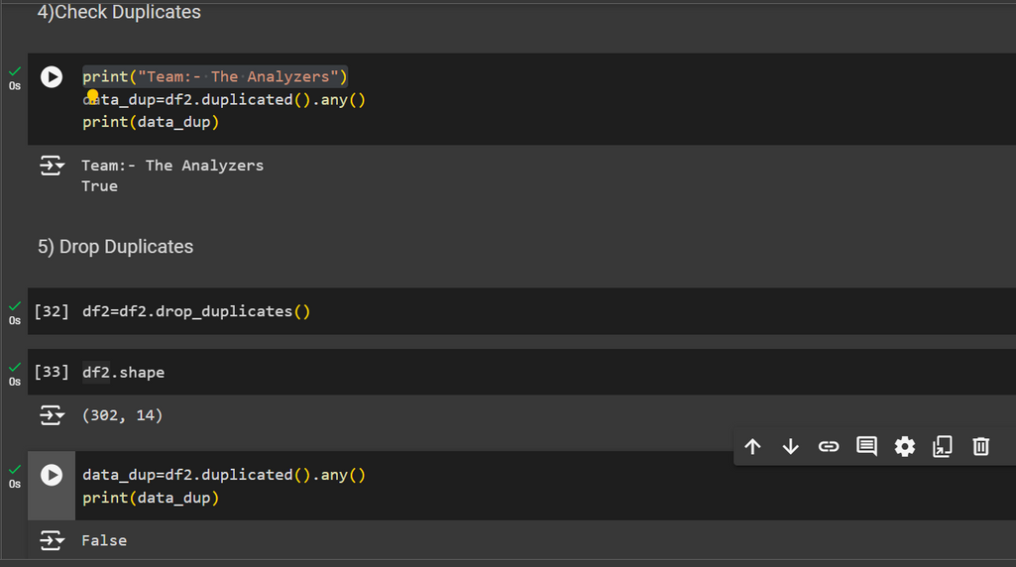
B. Data Preprocessing
1)Data Cleaning Methods:
In this Dataset we Drop Duplicates of rows value which is repeated in similar manner.

Slide 11
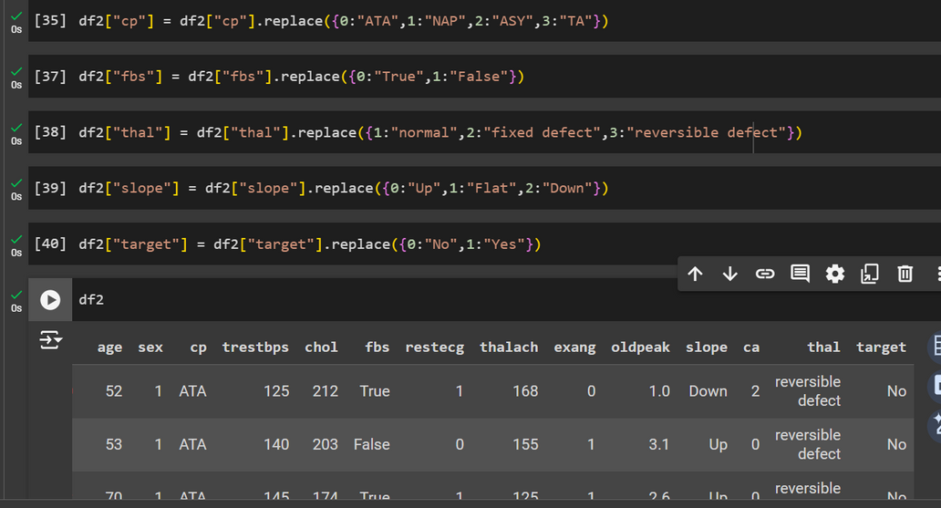
B. Data Preprocessing
3)Data Transformation Techniques
Normalization:- In this Dataset,we replace (0,1,2,3 into their respective attribute symptoms
Encoding Categorical Data
Aggregation

Slide 12
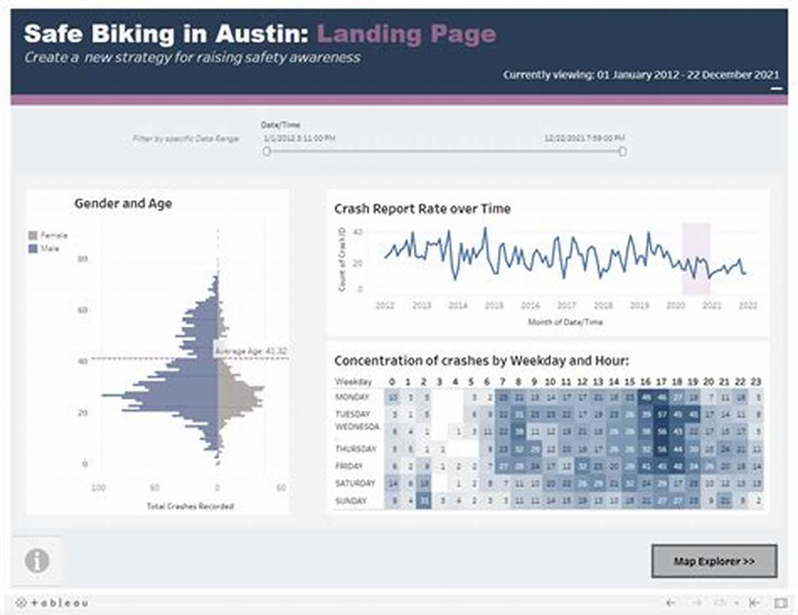
B. Data Visualization
1)Data Visualization Technique Used
Data visualization techniques are essential for effectively communicating data insights
Here are some commonly used techniques:Bar Charts,Histograms,Pie Charts,Heat Maps

Slide 13
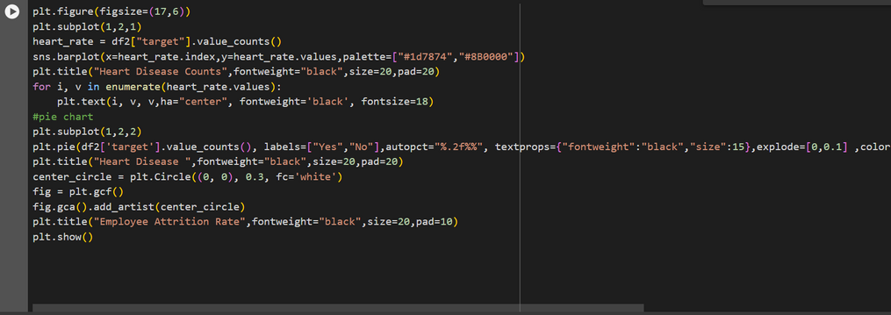
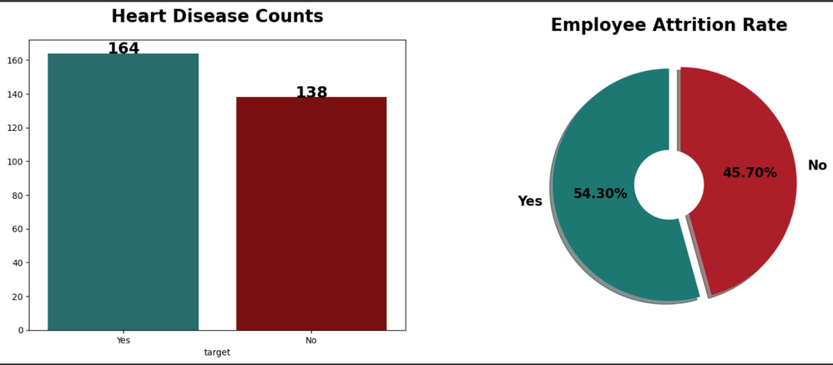
B. Data Visualization
2)Data Visualization, barplot

Slide 14
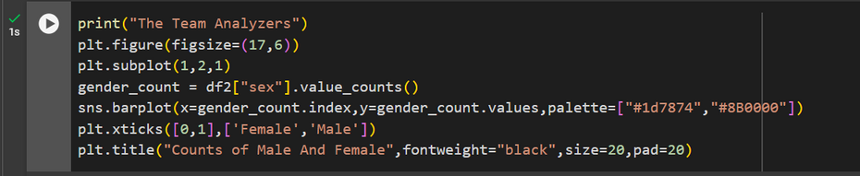
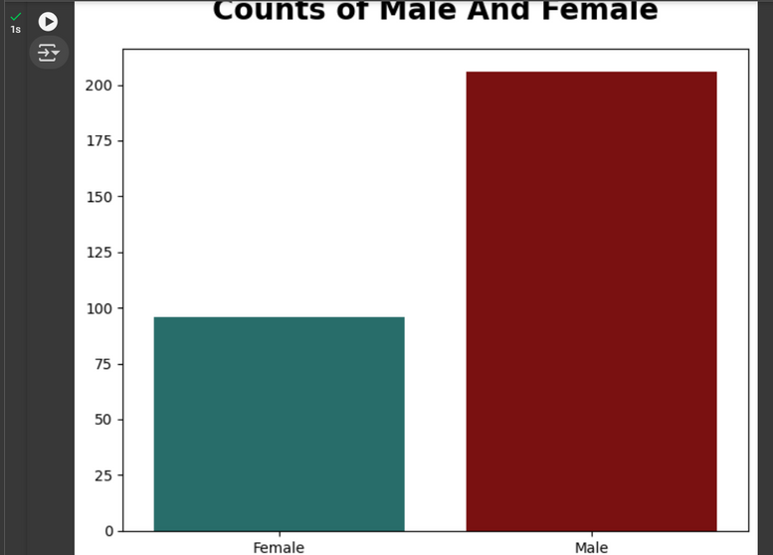
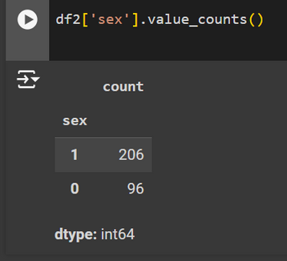
3)Data Visualization Counts Of male and female

Slide 15
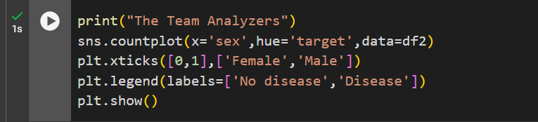
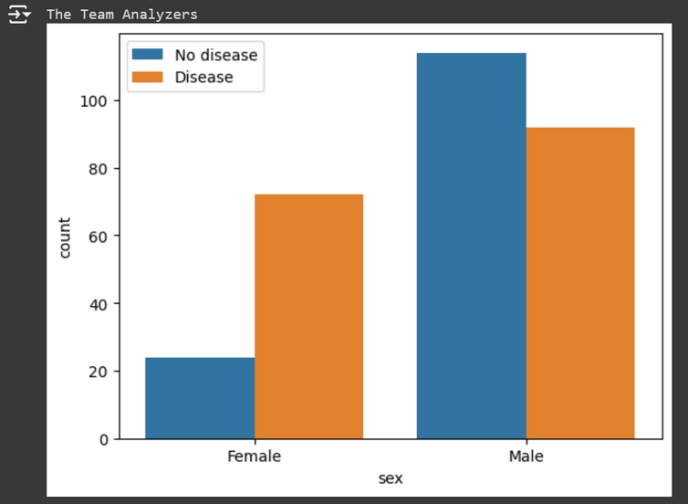
4)Find Gender Distribution According to target variable

Slide 16
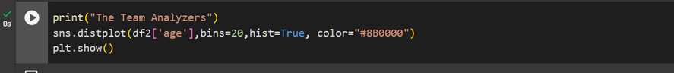
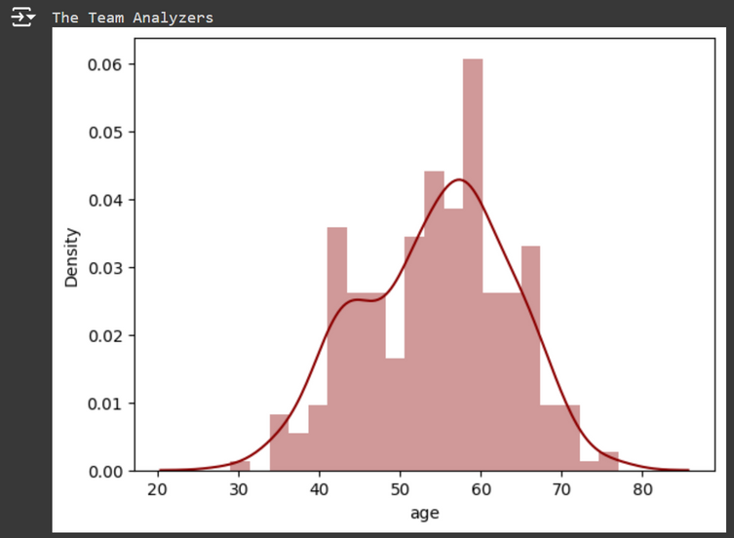
5)Check Age Distribution of Data variables

Slide 17
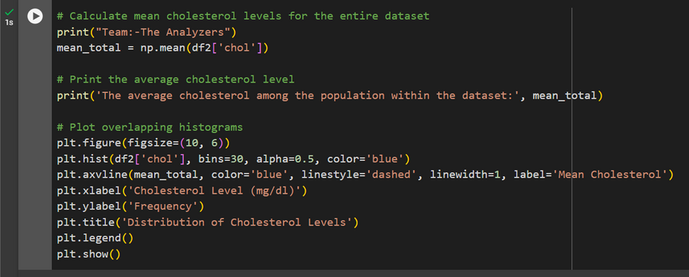
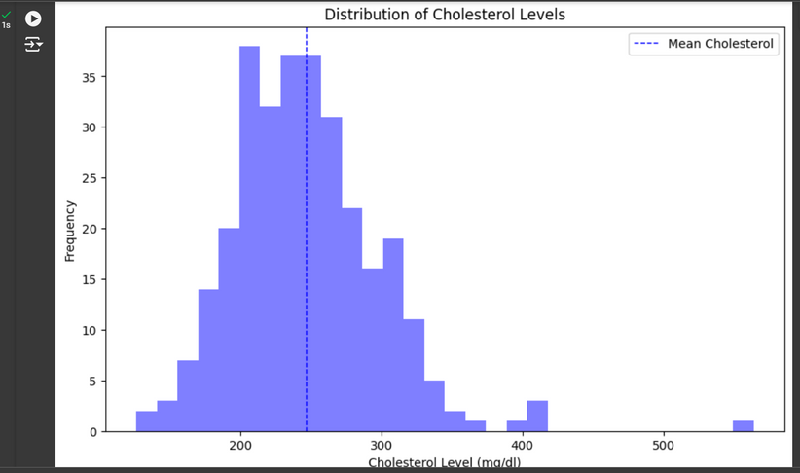
6) Calculate mean cholesterol level for entire dataset

Slide 18
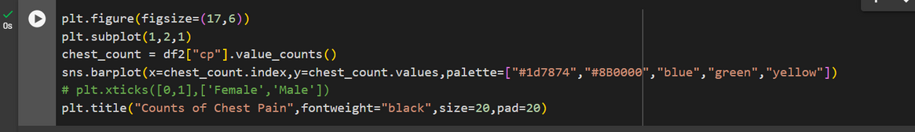
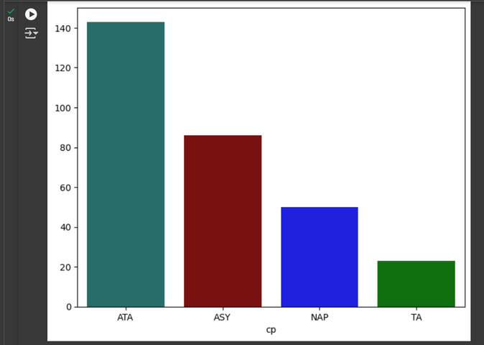
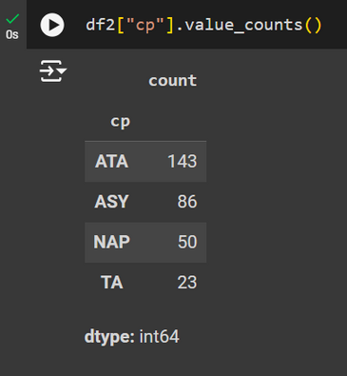
7) Counts of Chest Pain Type
ATA: A Typical angina
NAP: Non Anginal pain
ASY: Asymptomatic
TA: Typical Angina

Slide 19
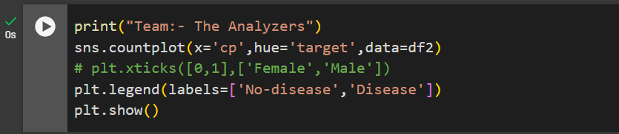
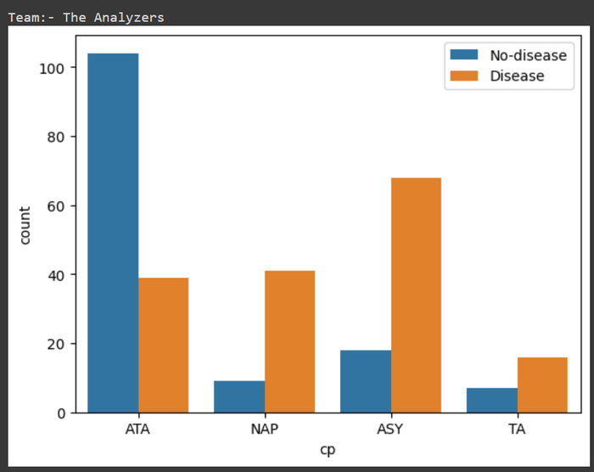
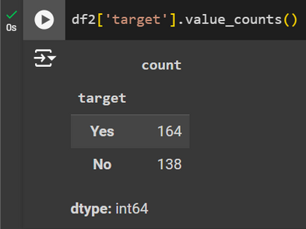
8) Show Distribution of Chest Pain As per ‘Target’ Variable:

Slide 20
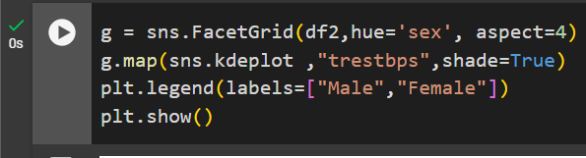
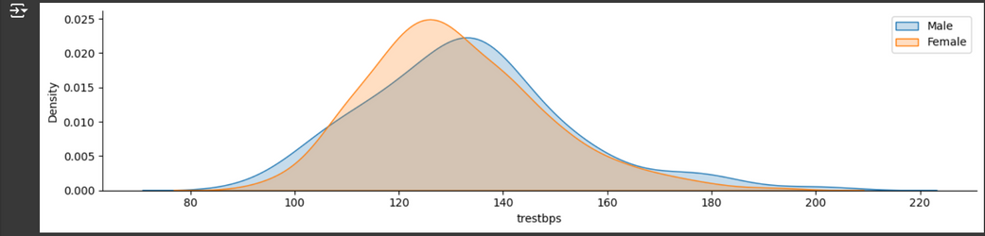
9) Compare resting blood sugar as per sex columns:

Slide 21
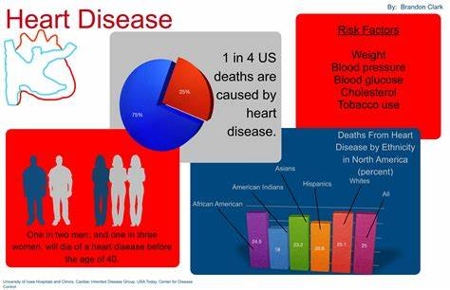
C. Data Analyzing
1)Analytical Tools And methd used
Statistical Analysis
Data Visualization
Machine Learning
Correlations
Predictions
Strategic Decisions:

Slide 22
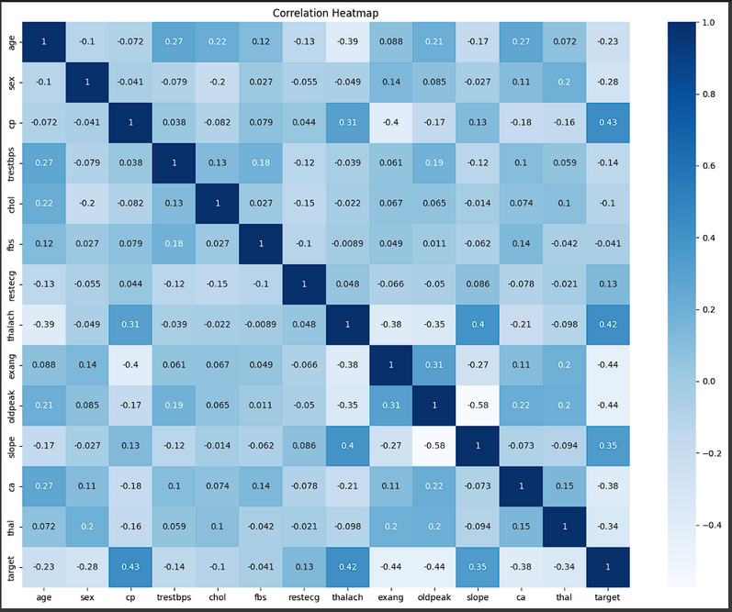
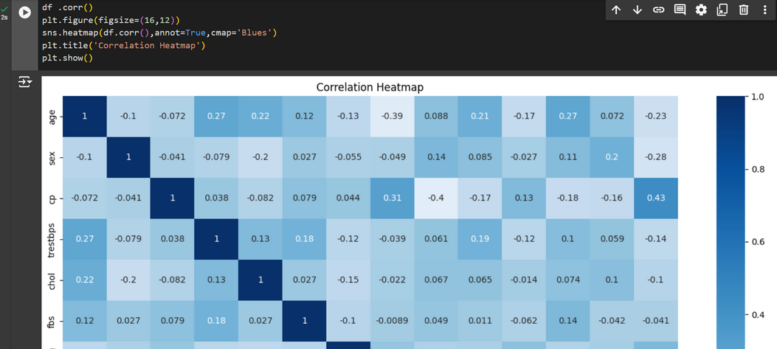
2)Correlation bw attributes of Dataset

Slide 23
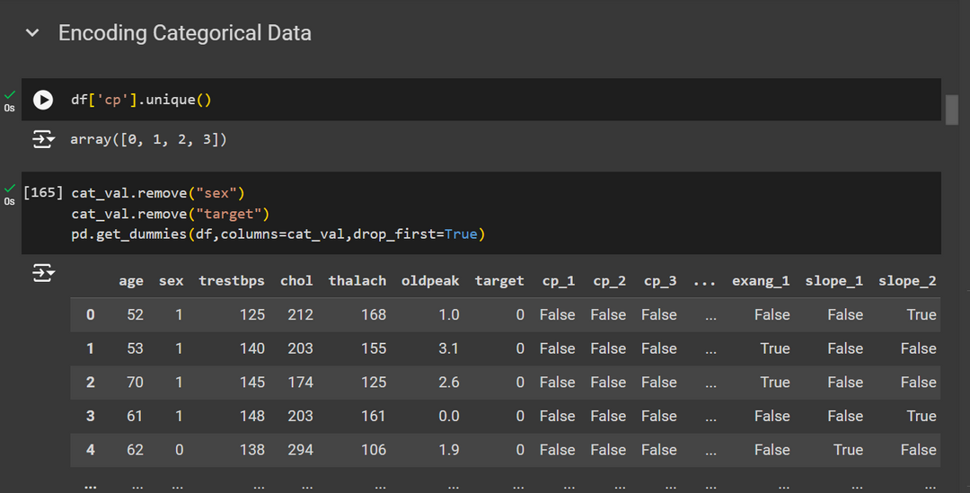
3) Encoding Categorical Data

Slide 24
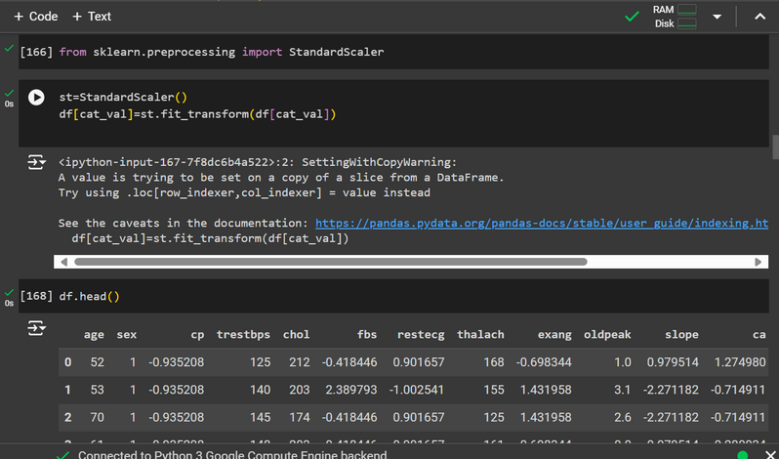
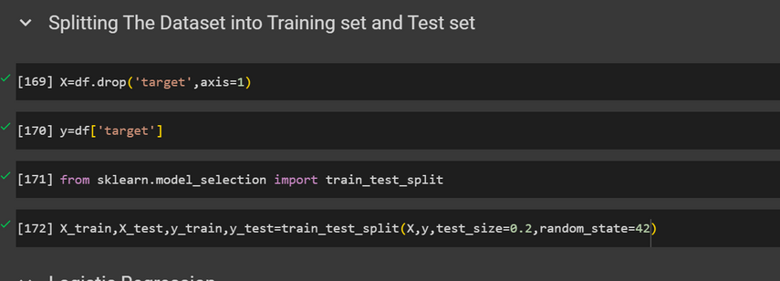
Splitting The Dataset into Training set and Test set:

Slide 25
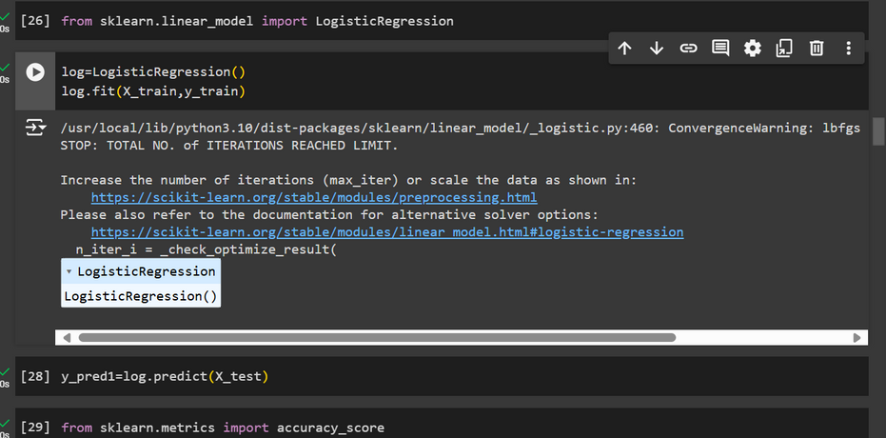
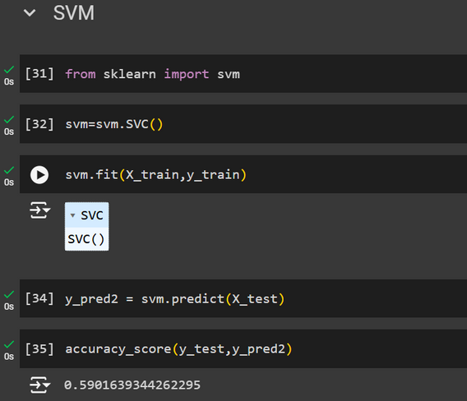
Feature Scaling:

Slide 26
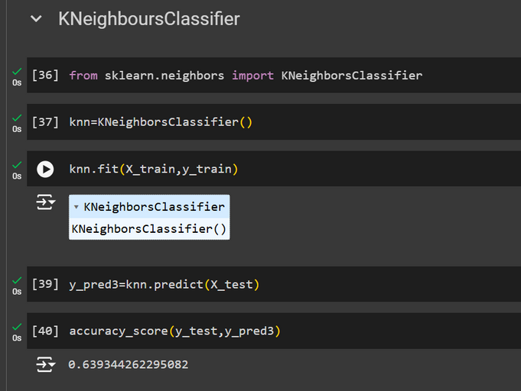
SVM And K Neighbors Classifier:

Slide 27
Conclusion:
1)Summary Of Findings
Predictive and Descriptive Analysis
Researchers have utilized various datasets, such as the HeartDisease Database and the South African Heart Disease Dataset, to develop predictive models using algorithms like Decision Trees, Naive Bayes, Support Vector Machines, and neural networks. These models aim to improve the accuracy of heart disease diagnosis by identifying patterns and associations in patient data1.
Echocardiography remains a crucial tool for diagnosing heart diseases, particularly rheumatic heart disease (RHD)
Some Links:-
https://www.acc.org/latest-in-cardiology/ten-points-to-remember/2020/10/30/18/51/contemporary-diagnosis-and-management
https://www.aafp.org/pubs/afp/issues/2012/0615/p1161.html

Slide 28
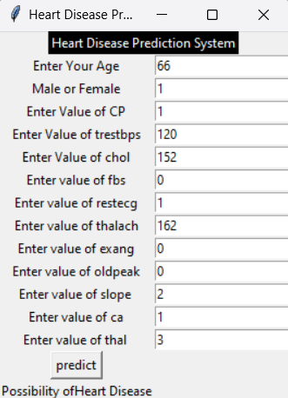
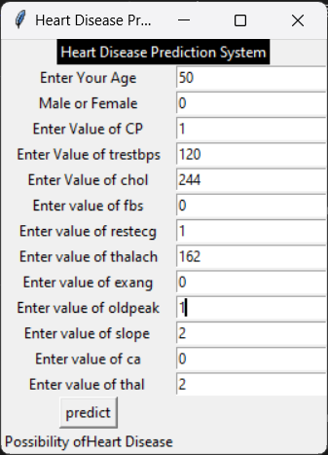
2) Impact of Proposed Solution
Improved Accuracy
Early Detection
Personalized Treatment Plans
Cost Efficiency
Resource Optimization
Research and Development
3) Future Work
Improved Accuracy Early Detection
Advanced Machine Learning
Clinical Trials and Validation Models
Patient Engagement and Education
Real-Time Monitoring and Alerts

Slide 29
References:
Data Sources:
Tools and Software Used:
Kaggle
Python: For data cleaning, analysis, and visualization, using libraries such as Pandas, NumPy, Matplotlib, and Seaborn.
Google Colab Notebook: For documenting the analysis process and visualizations.
Scikit-learn: For developing predictive models and machine learning algorithms.
Additional References
IBM masterclass: Mater class available on YouTube helped us to gain deep knowledge.
YouTube: Some video lectures from youtube help us in model predicting.
Blog Post: Blog post by some good Data Scientists also helped us in delivering this project.

Slide 30
Thanking
You

